Slide 1
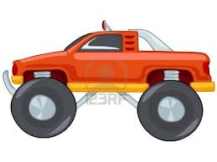
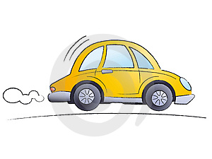
www.Comparethelocus.yolasite.com
Different Types of Loci’s
Car B
Home
The Locus equidistant from two points
Car A
Interception through the midpoint
Question
Show the locus of the car A that is driven through the route that is equidistant between car B and C ?
Explanation
The car A has driven between car B and C and made sure that the locus is equidistant between car C and B.
Car C

